Slide 1
Accotink Gorge
Imperiled Biodiversity

Slide 2
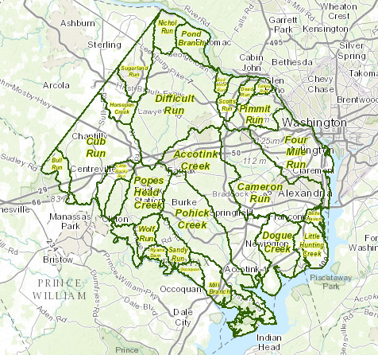
Where is the Accotink Gorge located?

Slide 3
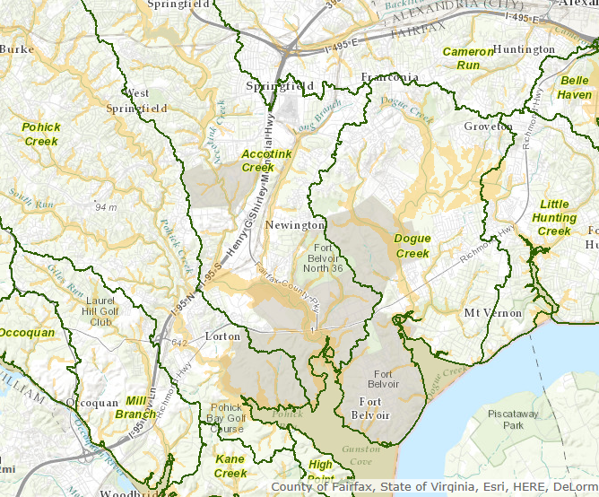
Where Accotink Creek crosses the Fall Line,
In Springfield

Slide 4
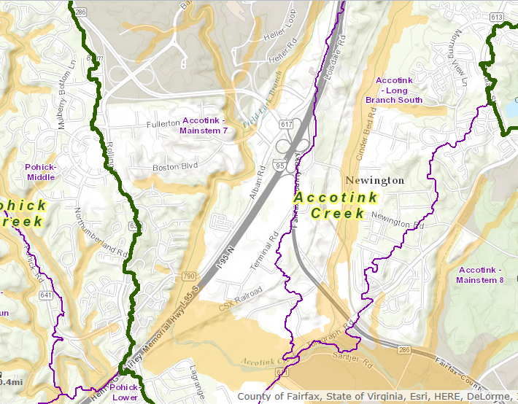

Just west of I-95
Just south of Fairfax County Parkway &
Fort Belvoir North

Slide 5
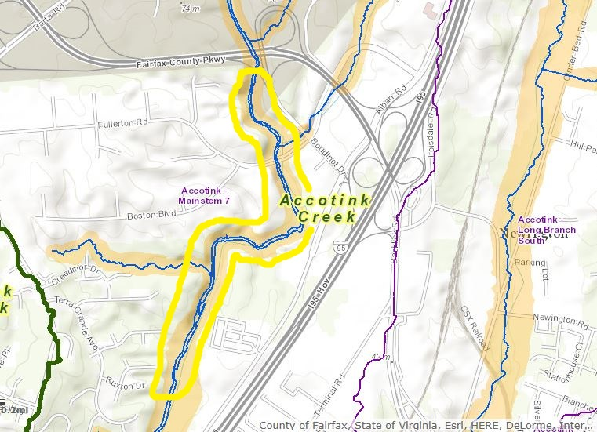
Roughly one mile in length

Slide 6
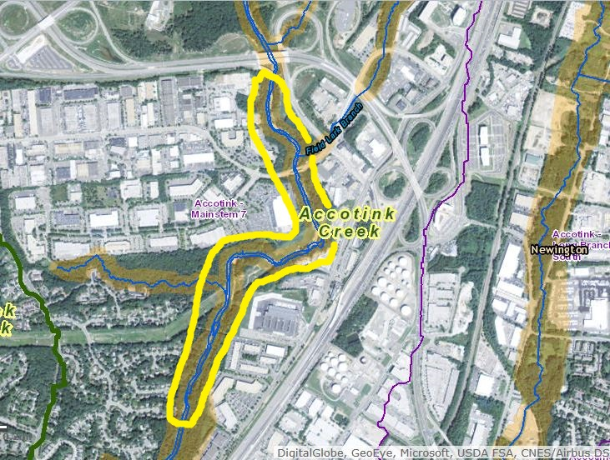
Closely bounded by commercial/industrial zones

Slide 7
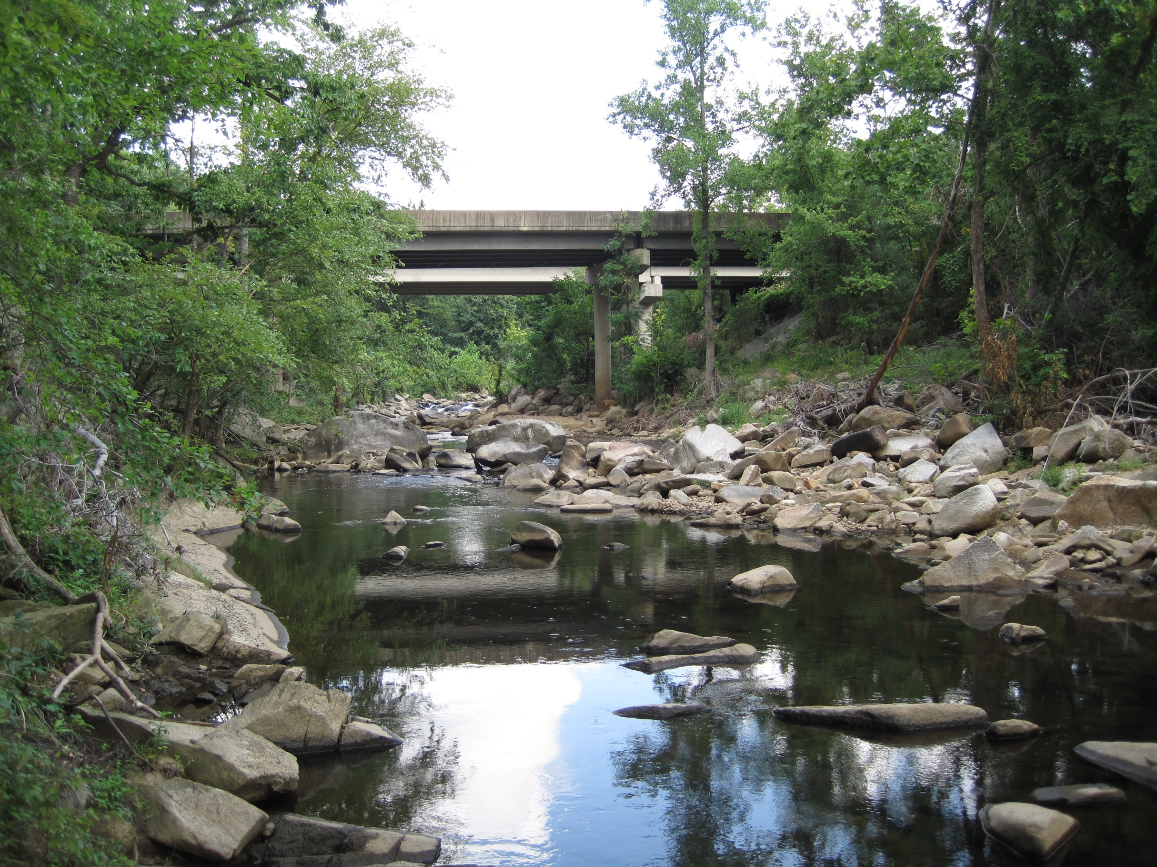

Slide 8
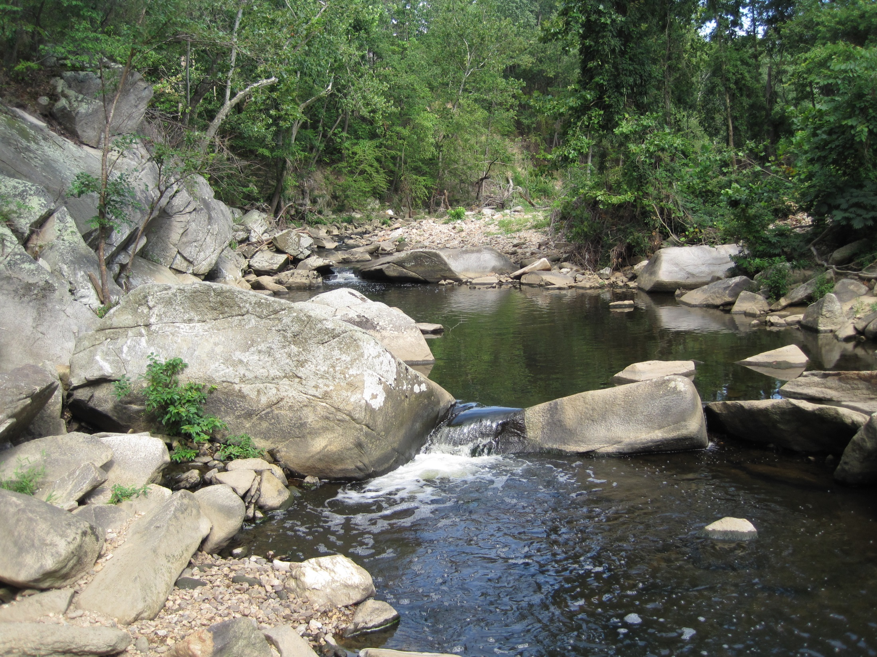

Slide 9
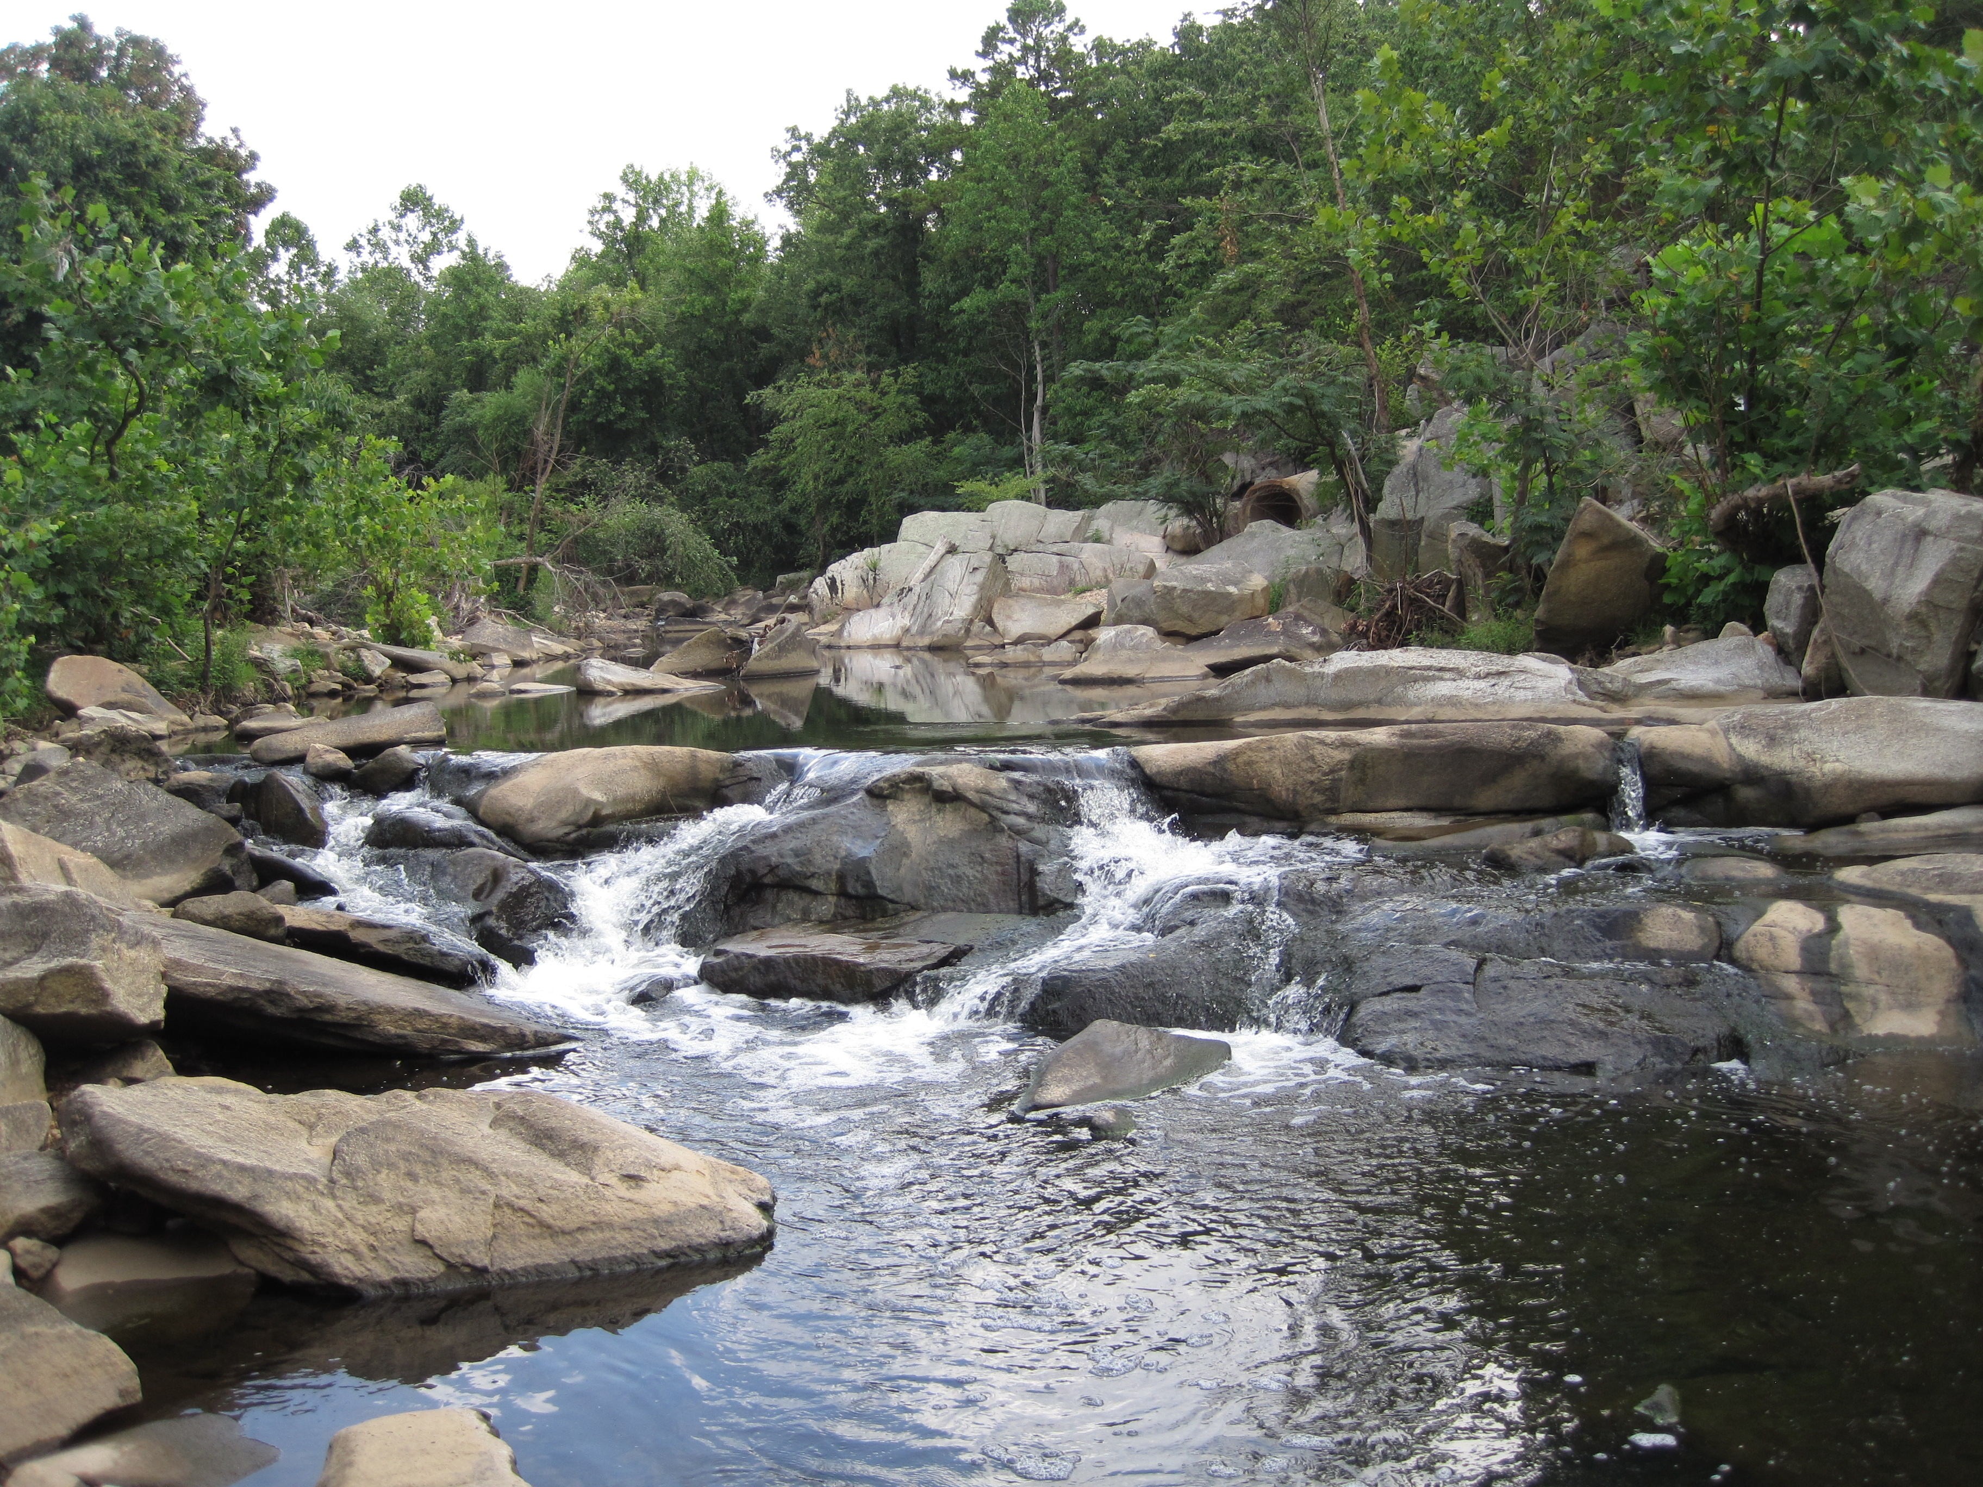

Slide 10
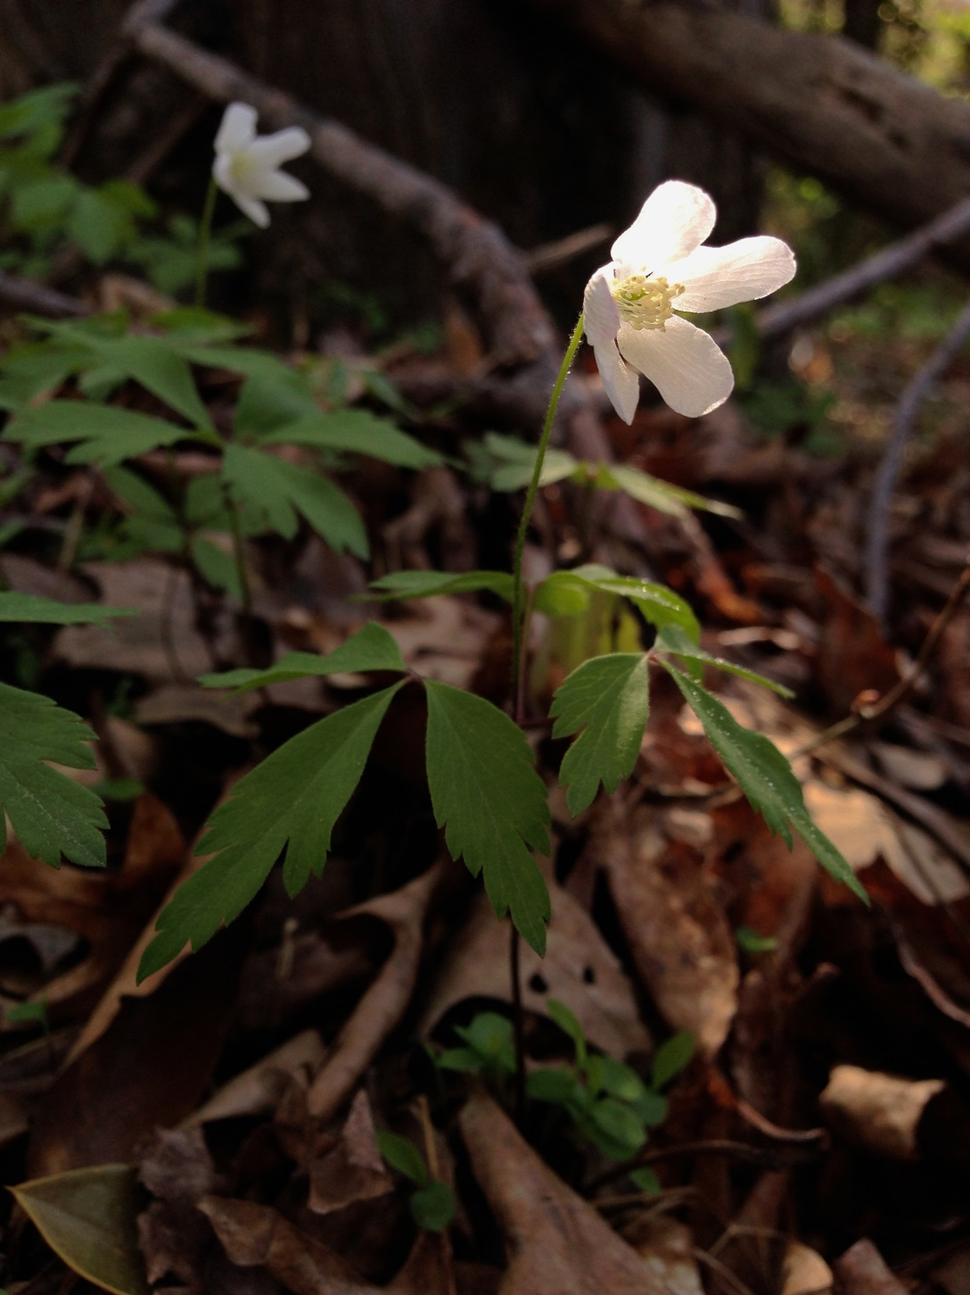
“The Accotink Gorge is truly one of the most biodiverse locations I have ever had the privilege of exploring.”
Anemone quinquefolia, Wood anemone

Slide 11
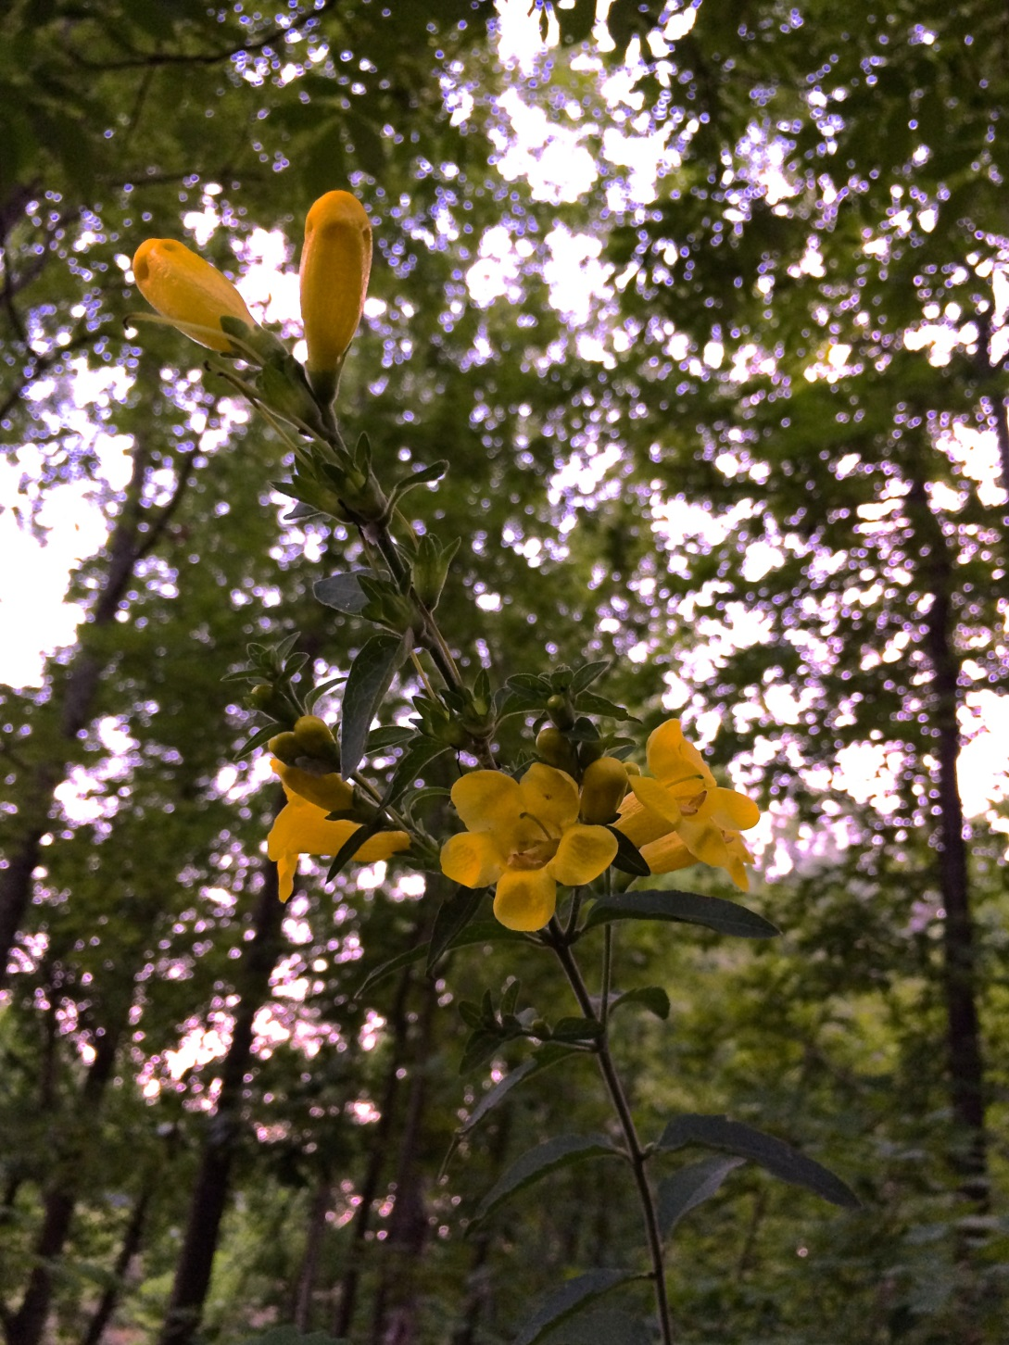
Aureolaria virginica, Downy false foxglove

Slide 12
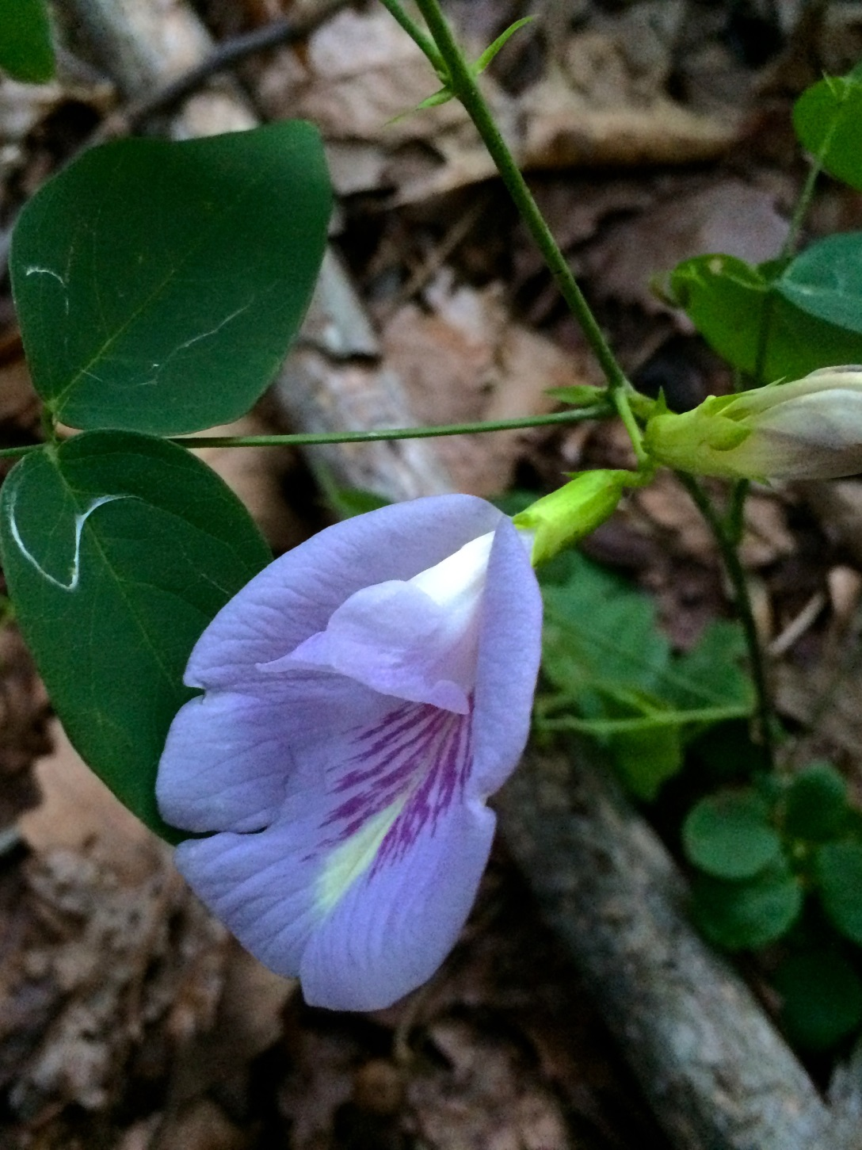
Clitoria mariana, Butterfly pea

Slide 13
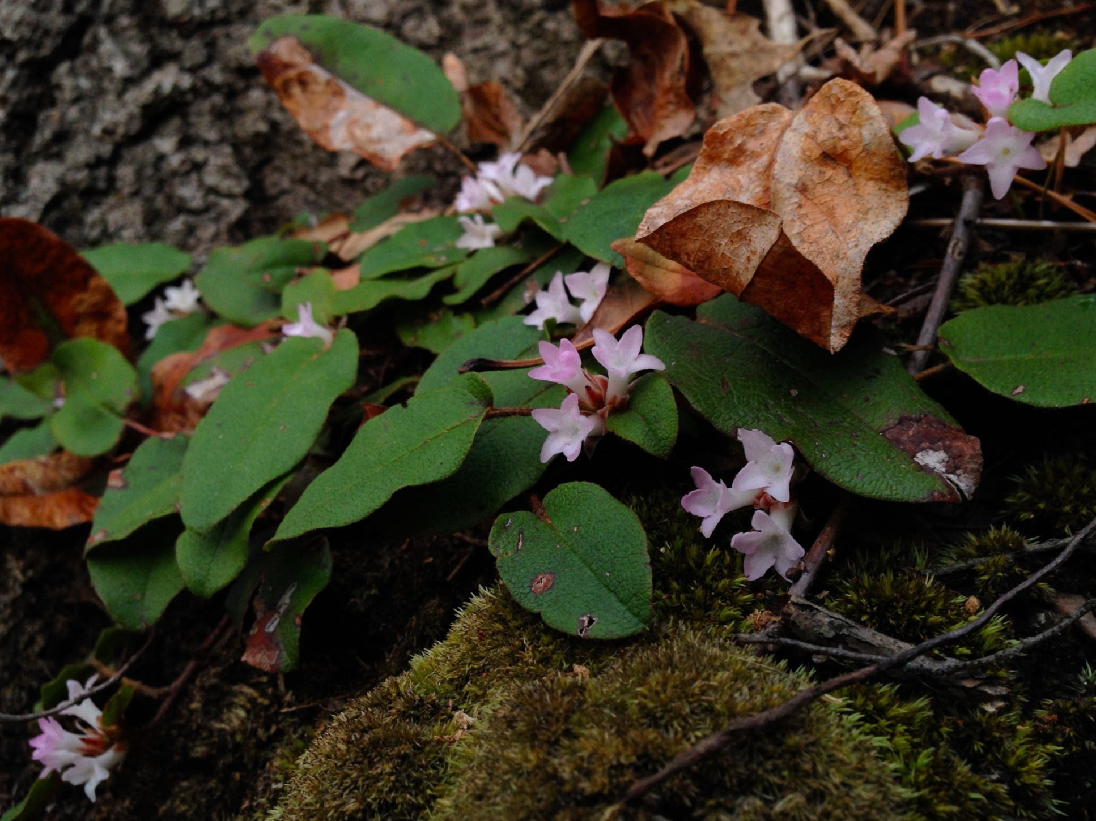
Epigaea repens, Mayflower

Slide 14
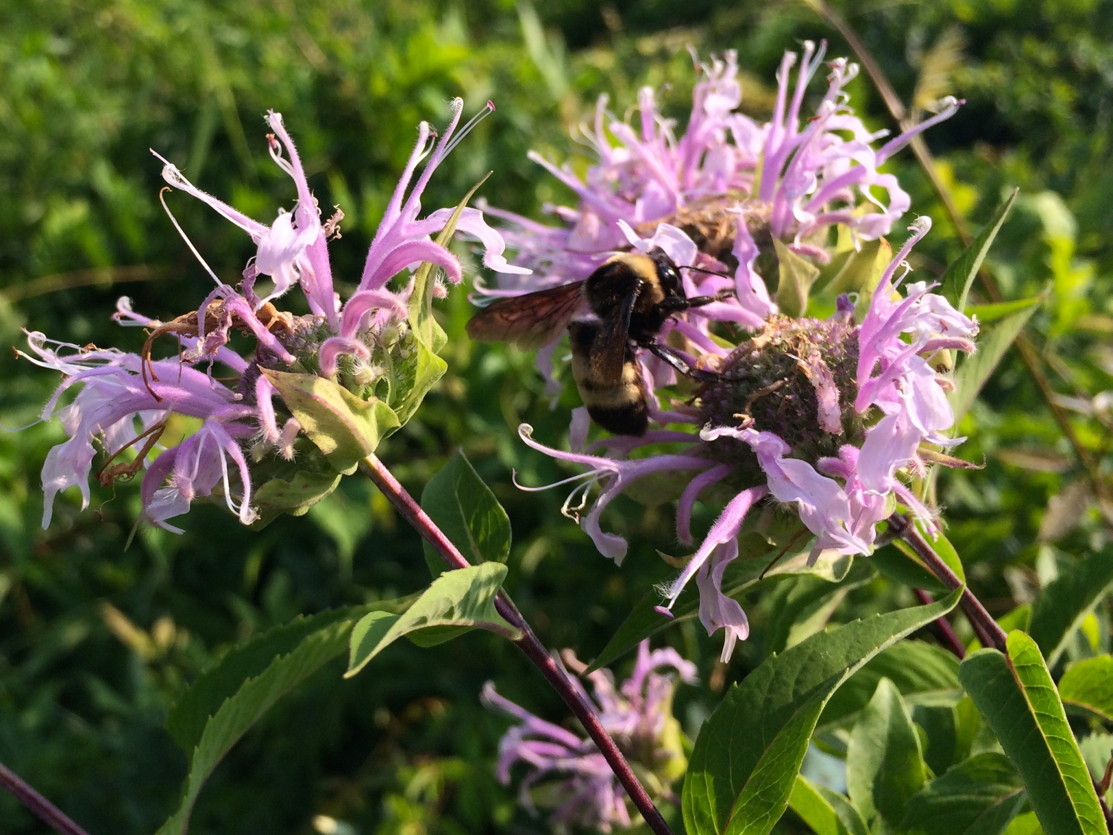
Monarda fistulosa, Wild bergamot

Slide 15
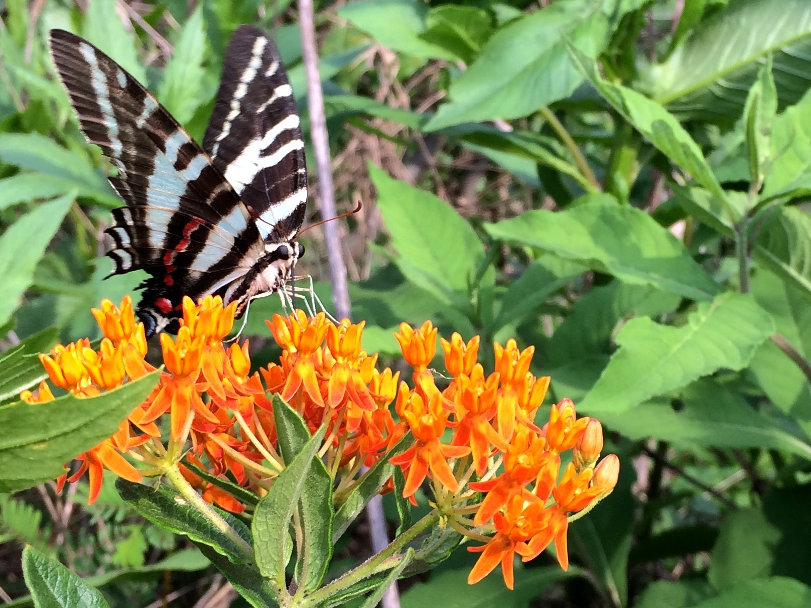
Protographium Marcellus, Zebra swallowtail, on Asclepias tuberosa, Butterfly weed

Slide 16
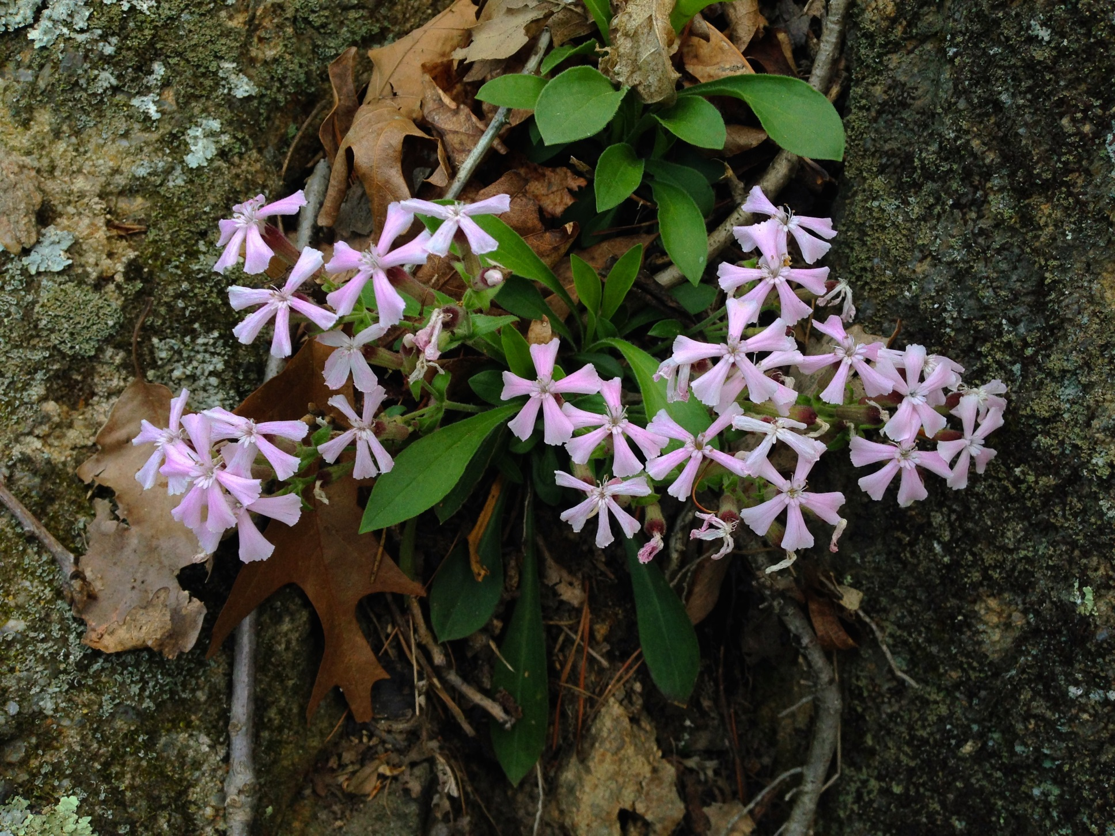
Silene caroliniana, Wild pink

Slide 17
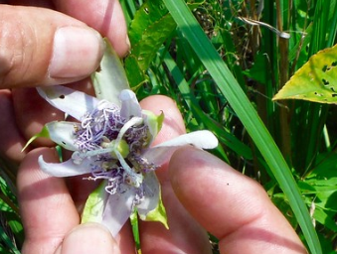
Passiflora incarnata,
Purple passionflower

Slide 18
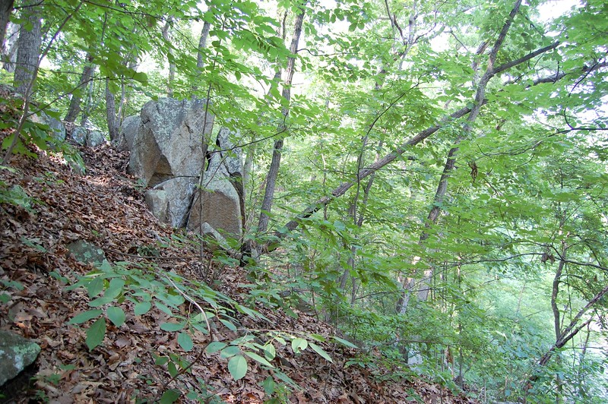
In the southern portion of Accotink Gorge exists one of the more diverse examples of oak hickory heath forest in the entire Fairfax County park system.

Slide 19
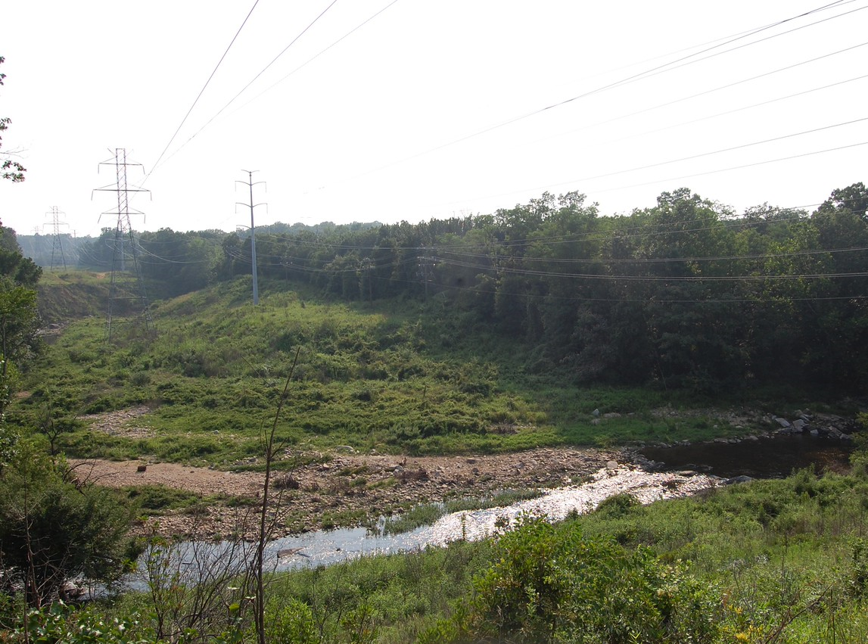
Dominion Power clearing maintains habitat for meadow species adjacent to forested areas of the Accotink Gorge.

Slide 20
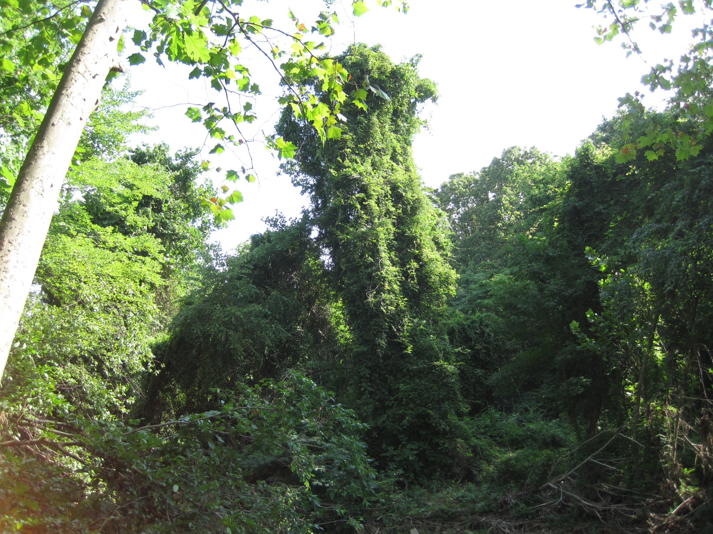
It is not too late to save this oasis, but it will be soon.
Wisteria sinensis (Chinese wisteria) vines are rapidly killing its canopy trees.

Slide 21
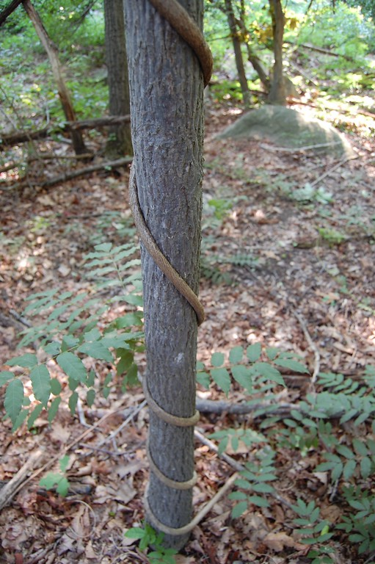
Wisteria sinensis girdles young trees.

Slide 22
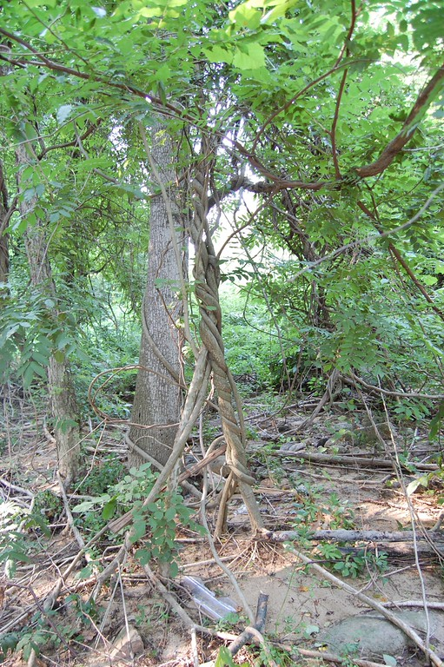
Wisteria vines spread both upward into trees and snake along the ground.

Slide 23
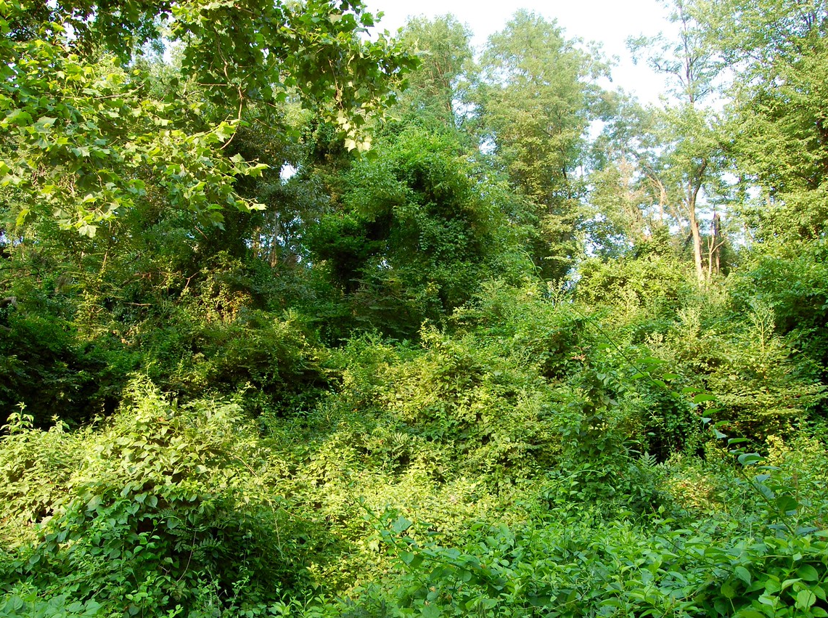
Parts of the forest are completely obscured by wisteria.

Slide 24
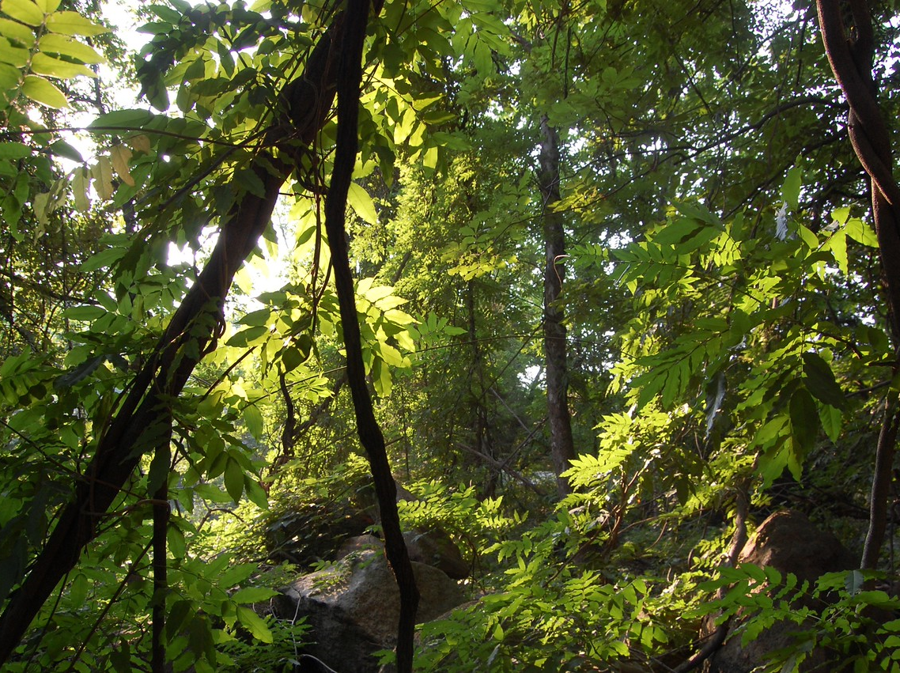
Leaving little sunlight for native plants below.

Slide 25
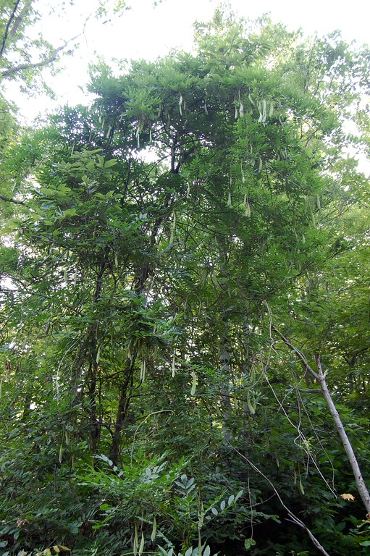
Wisteria seed production is appallingly fecund, facilitating colonization of new areas.

Slide 26
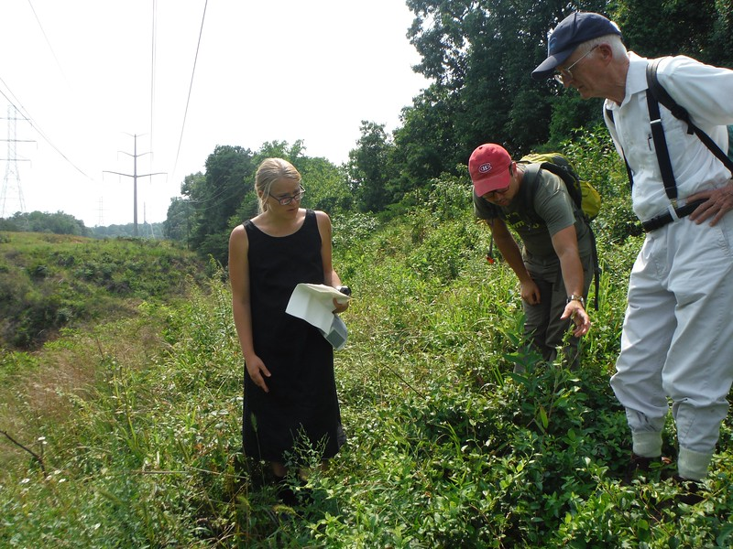
Citizen naturalists seek solutions to preserve this biological gem.

Slide 27
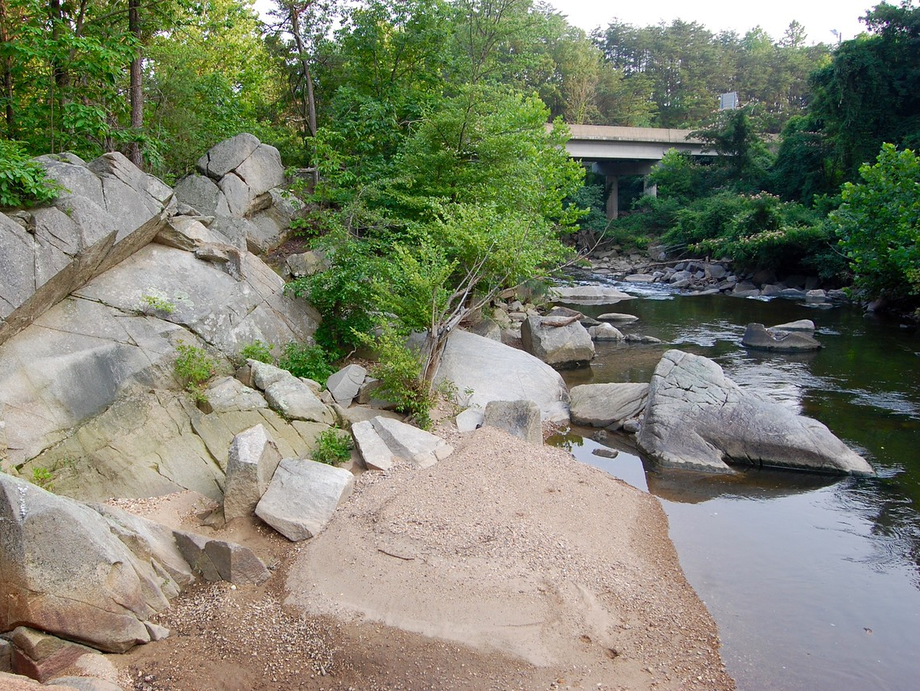

Slide 28
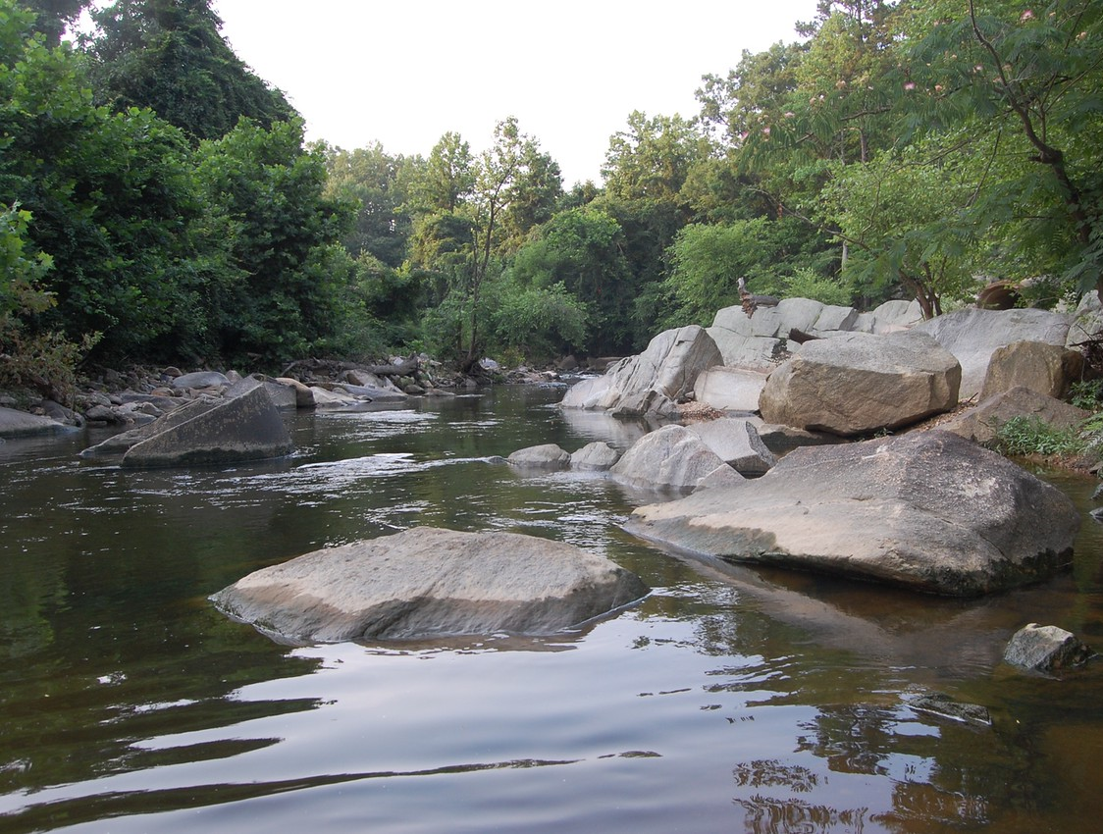

Slide 29
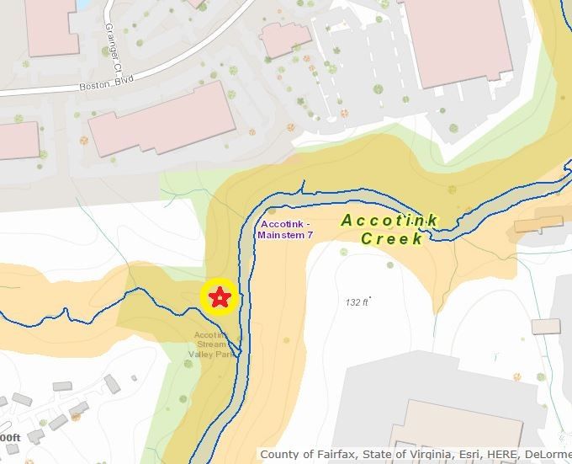
The high dry rocky oak hickory forest, which is just starting to be invaded, is where the Wisteria removal should begin, as it contains the most uncommon species.

Slide 30
Future action?
Beyond the headland area, the task is formidable.
To get there:
• We will need to muster money and manpower adequate to the job..
• Dominion, Fort Belvoir biologists, and VDOT should be involved.
• Partnership with any and all interested groups is welcome.
• We will need to appeal to neighboring commercial entities.
• Volunteers alone are unlikely to suffice.
• We will need grants to actually hire people and licensed applicators.
• This is an Eternal Commitment. The wisteria will never give up.

